Slide 1

Disk & File System Management
CSC 235 Introduction to Linux, Linux Admin & Mgmt
Instructor, Joel C. Nonnweiler
Email: jnonnweiler@stmartin.edu

Slide 2
Agenda
File System Maintenance
Disk Quotas
Ownership
Permissions
The unmask Command
Special Permissions
Access Control Lists
Archive & Backup
Troubleshooting Storage

Slide 3
File System Maintenance
du, df, lsof, fuser, and fsck commands

Slide 4
Key Terms/Definitions
Free disk space
Bad blocks
The area of a hard disk to which new data can be written.
A bad block is a section on a disk drive to which data can no longer be written to read from.

Slide 5
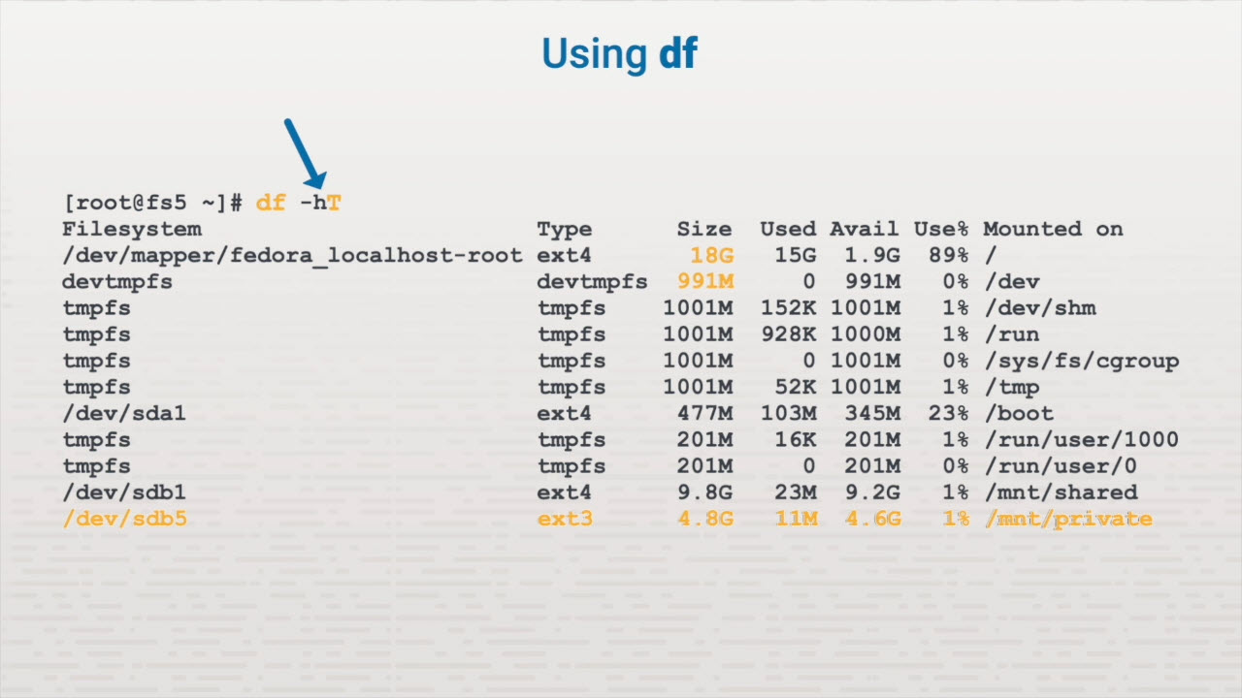
File System Maintenance

Slide 6
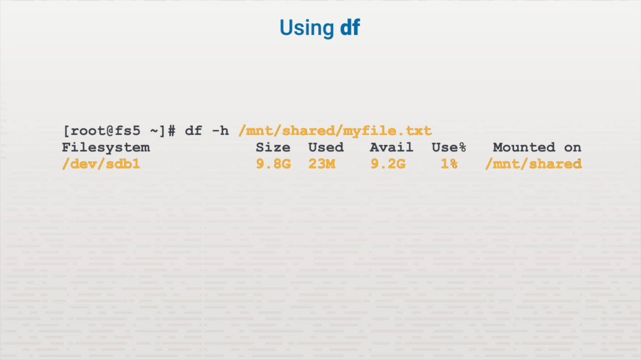
File System Maintenance

Slide 7
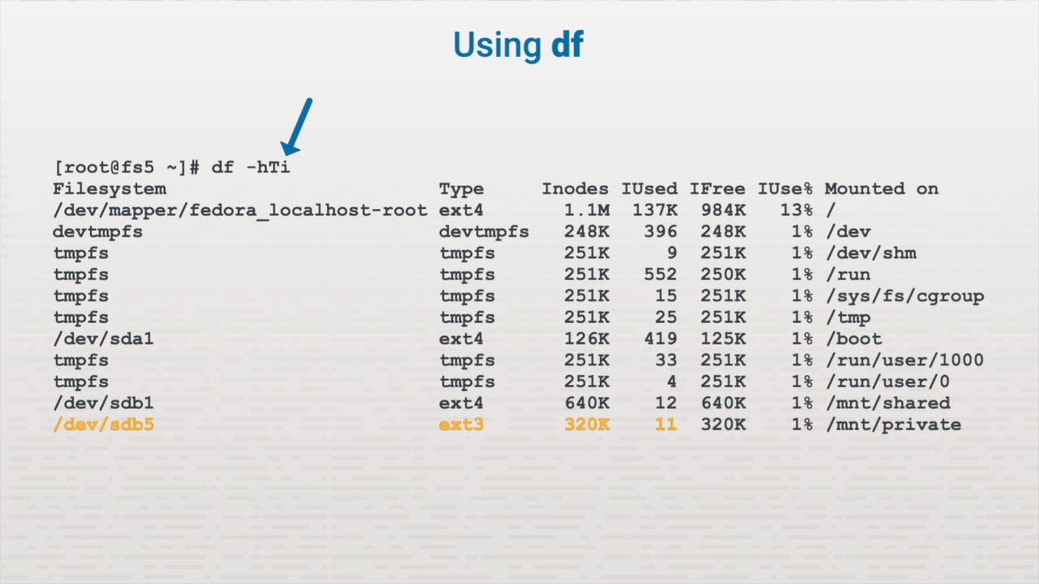
File System Maintenance

Slide 8
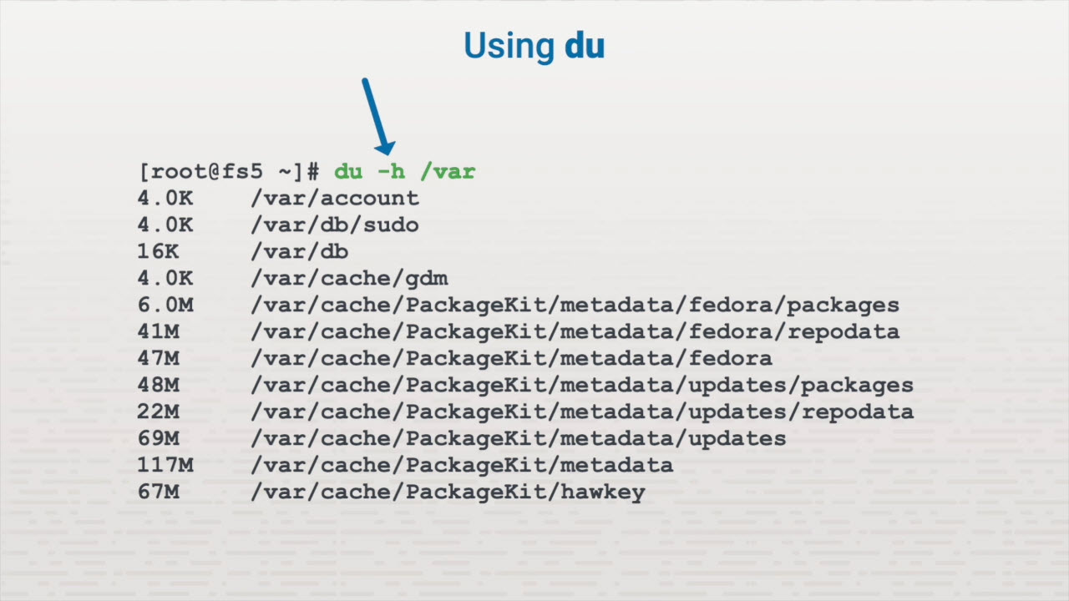
File System Maintenance

Slide 9
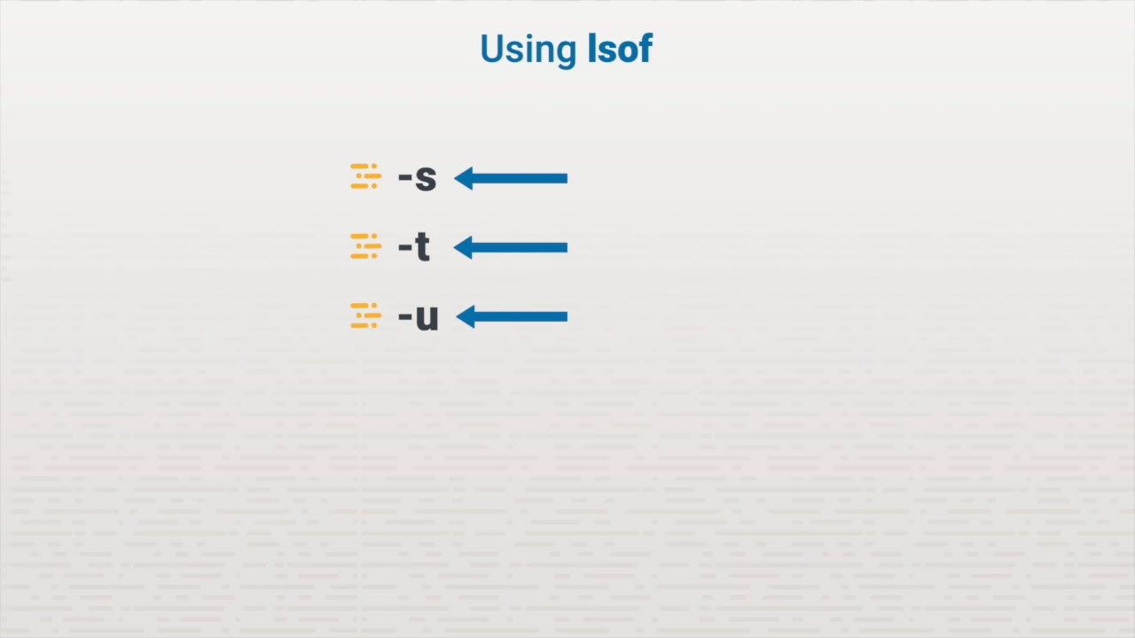
File System Maintenance

Slide 10
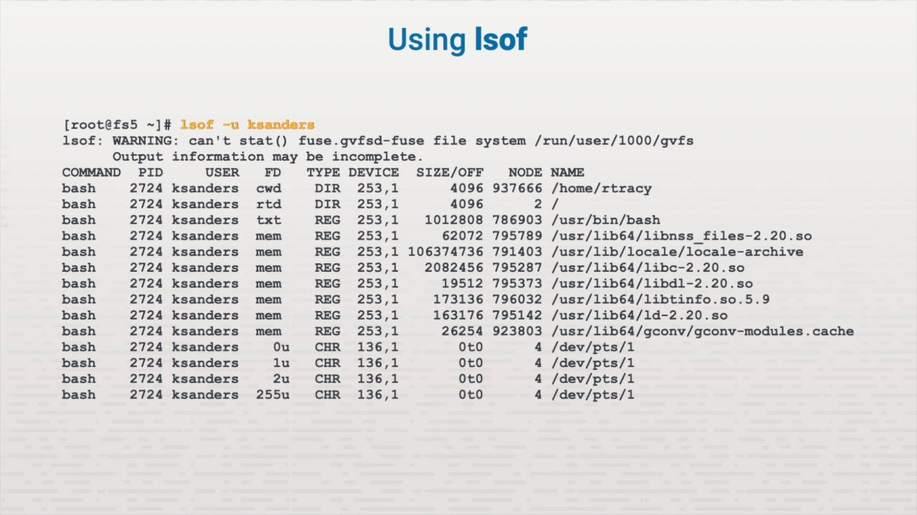
File System Maintenance

Slide 11
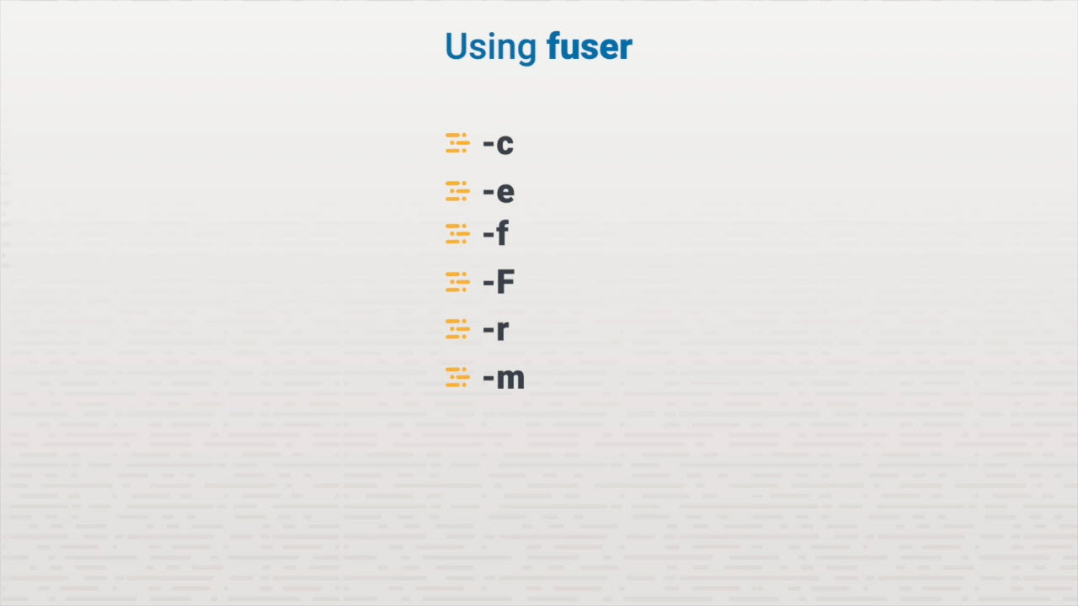
File System Maintenance

Slide 12
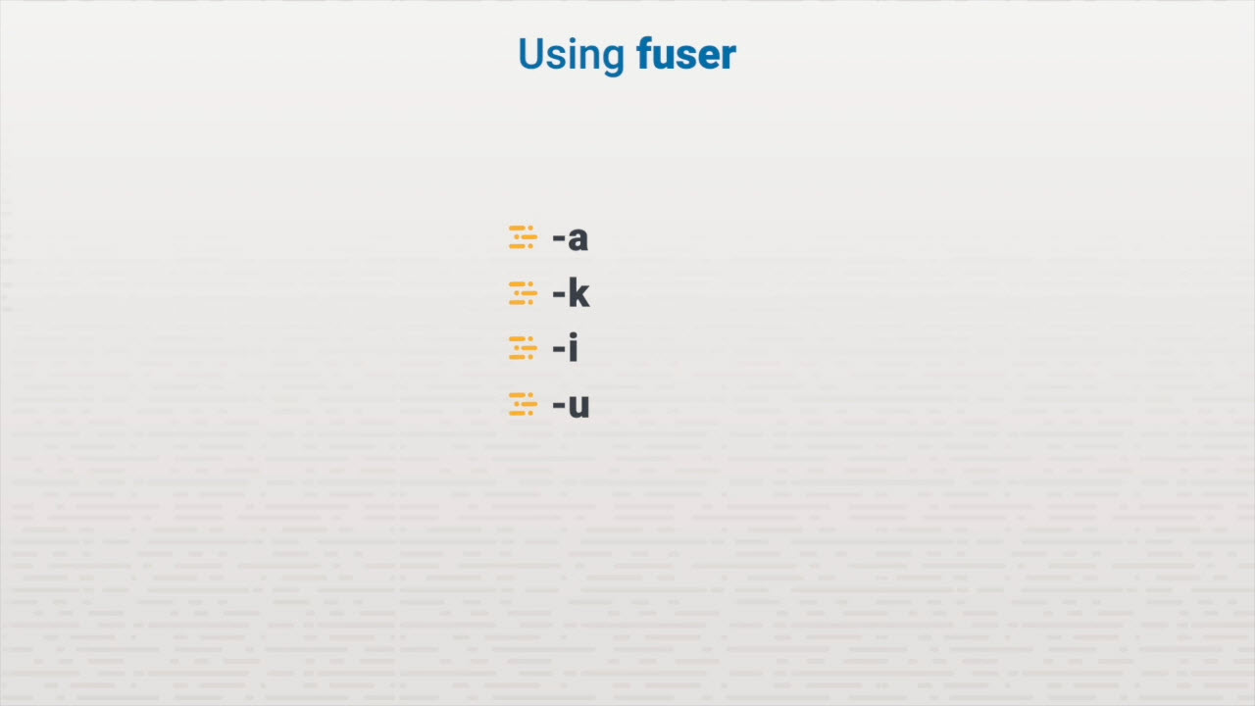
File System Maintenance

Slide 13
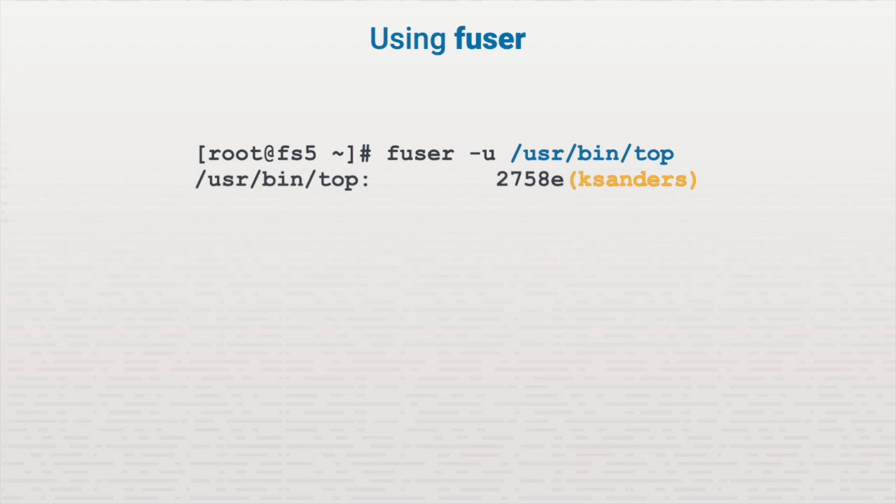
File System Maintenance

Slide 14
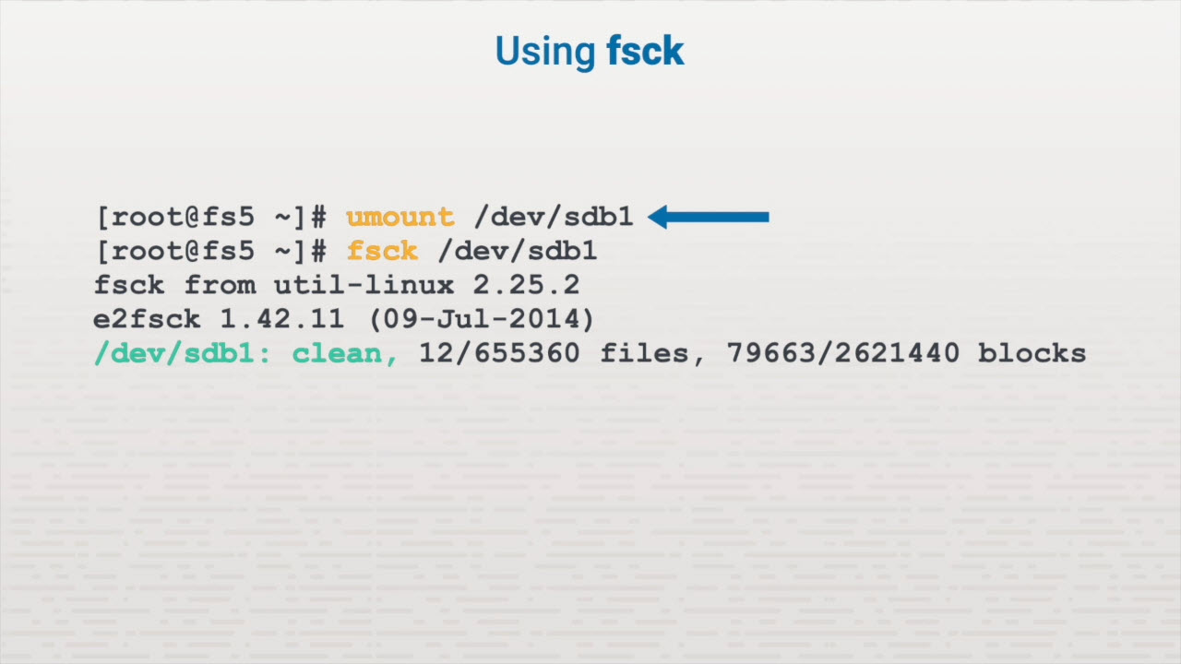
File System Maintenance

Slide 15
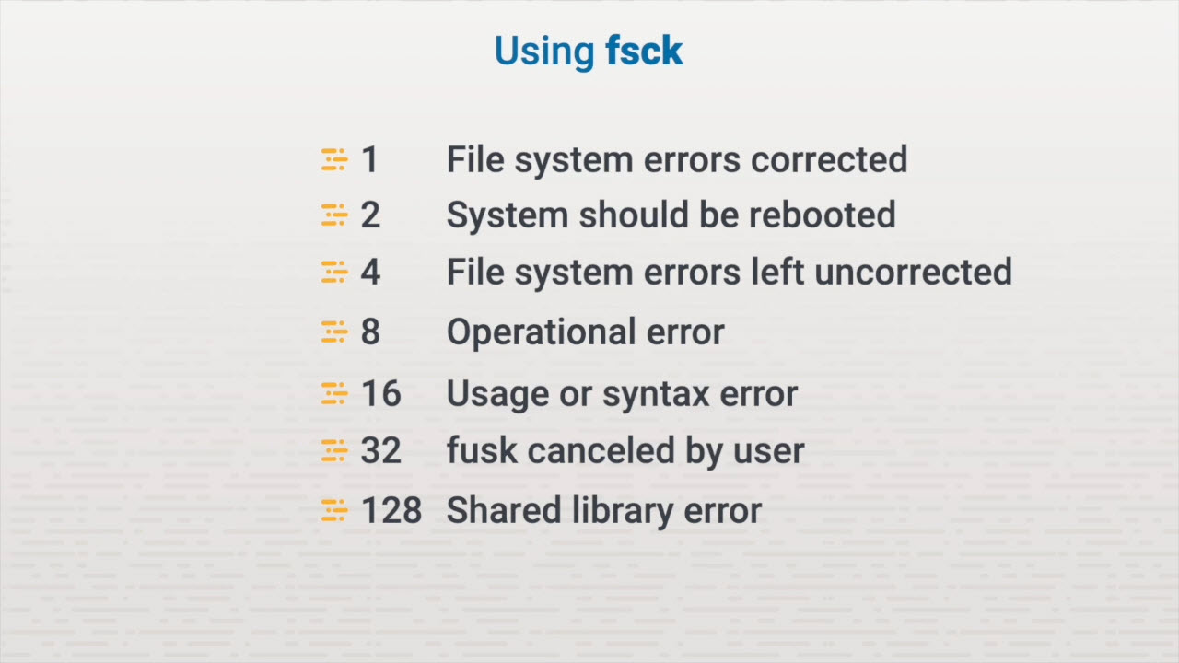
File System Maintenance

Slide 16
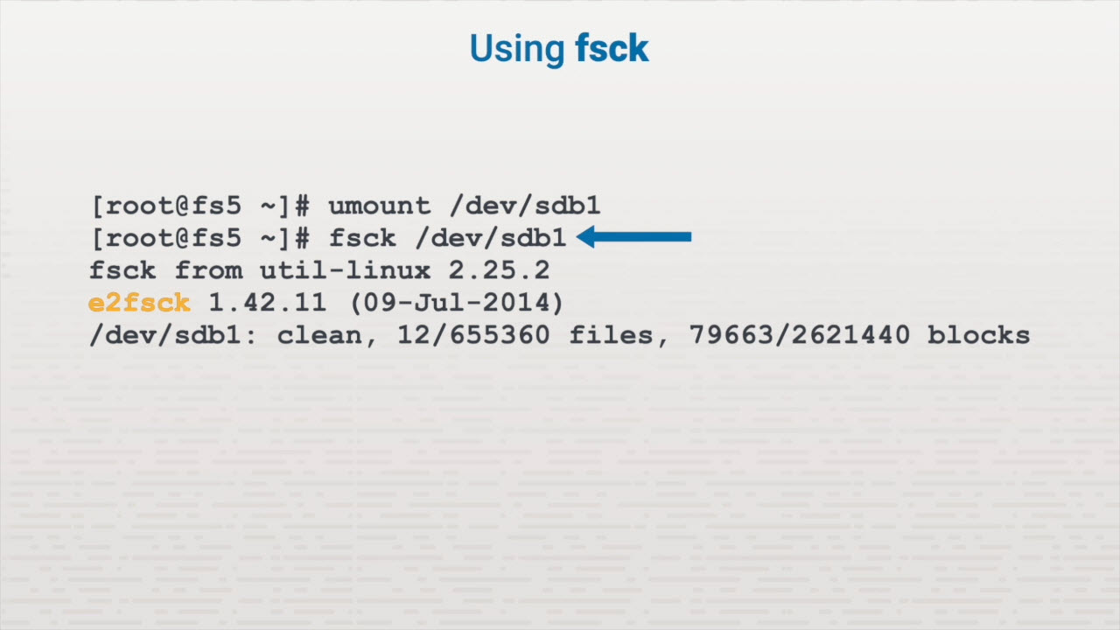
File System Maintenance

Slide 17
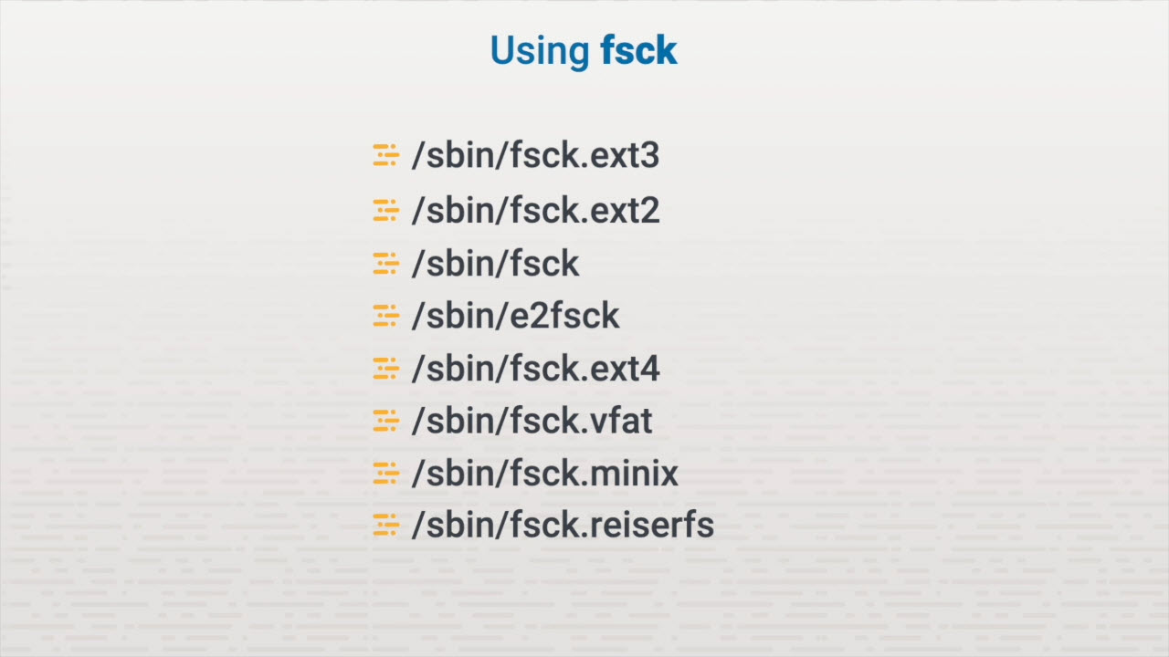
File System Maintenance

Slide 18
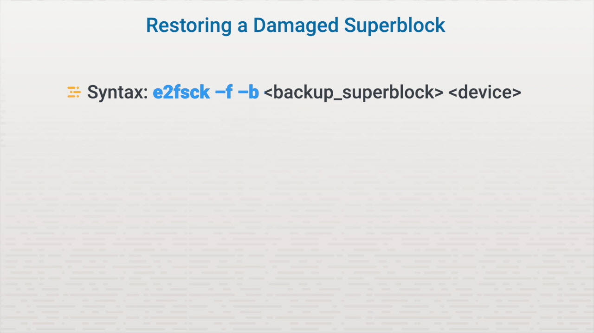
File System Maintenance

Slide 19
Disk Quotas
User and group quotas
Soft & Hard limits
Block & Inode usage quotas

Slide 20
Key Terms/Definitions
Disk quota
Prevents a user or group from using a disproportionate amount of disk space on a volume.

Slide 21
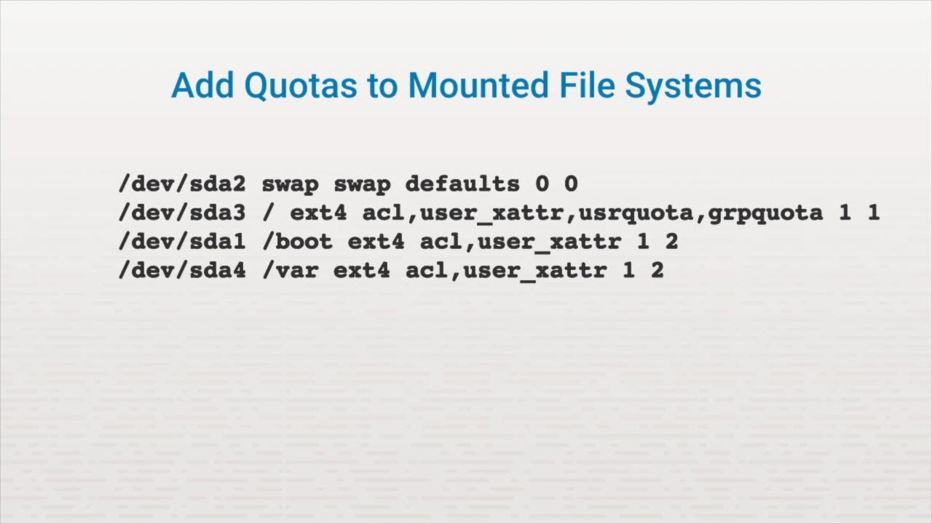
Disk Quotas

Slide 22
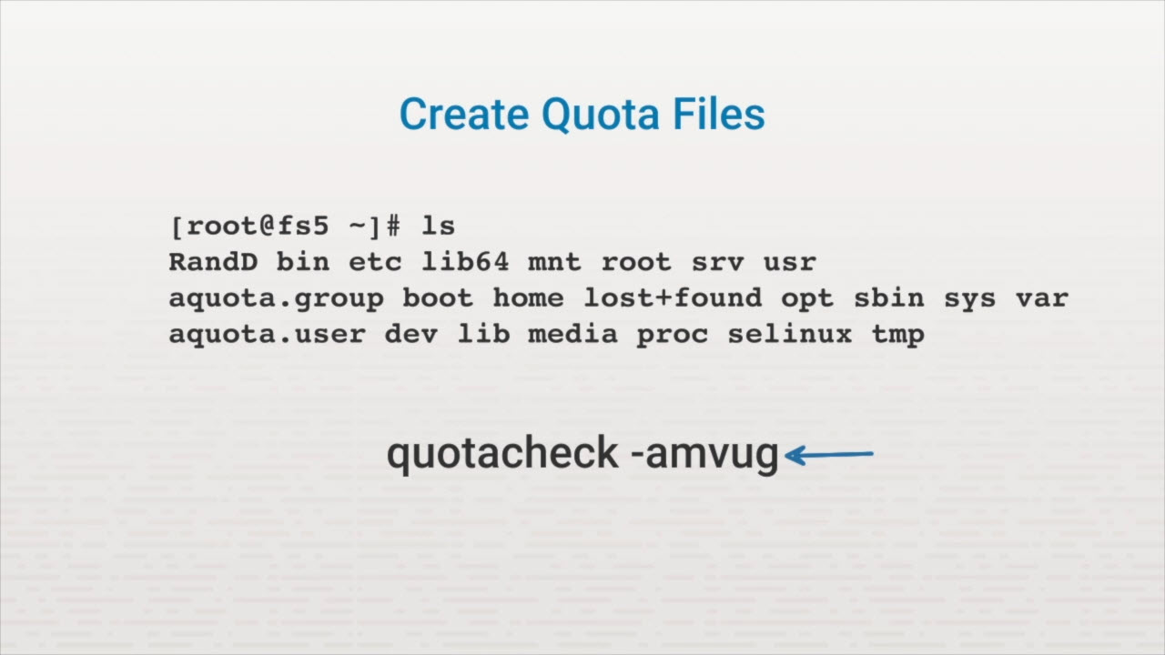
Disk Quotas

Slide 23
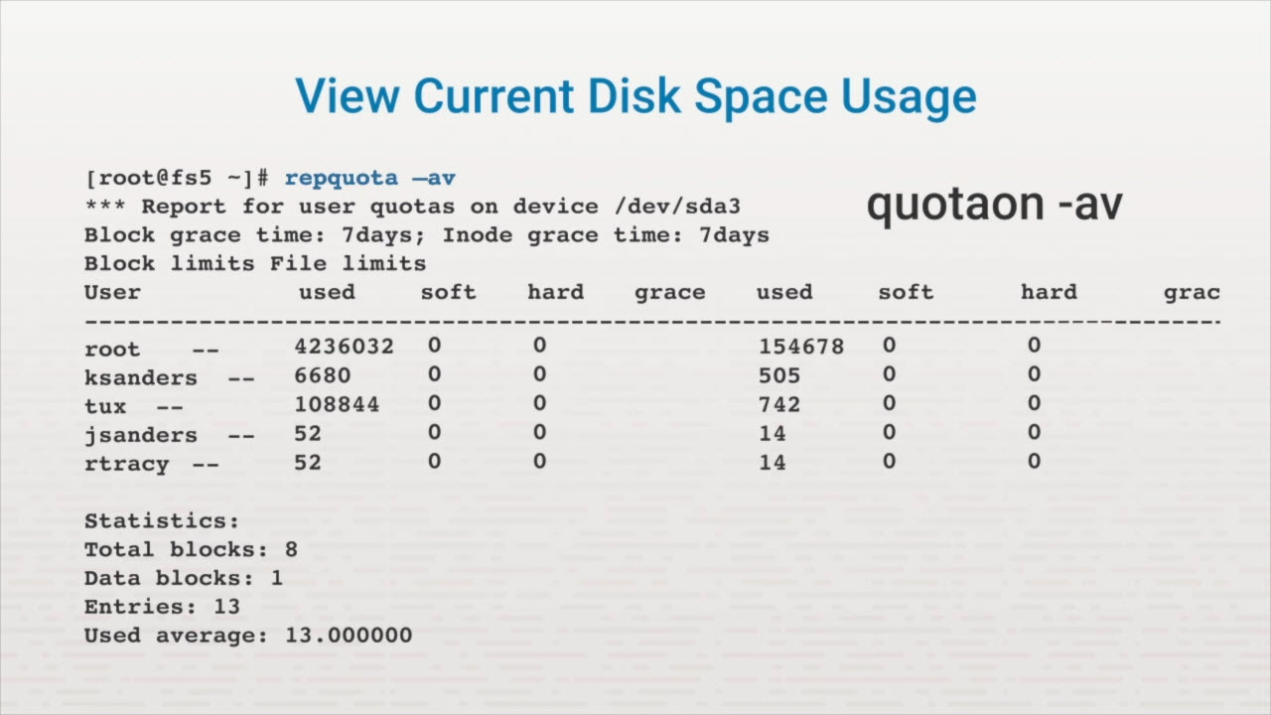
Disk Quotas

Slide 24
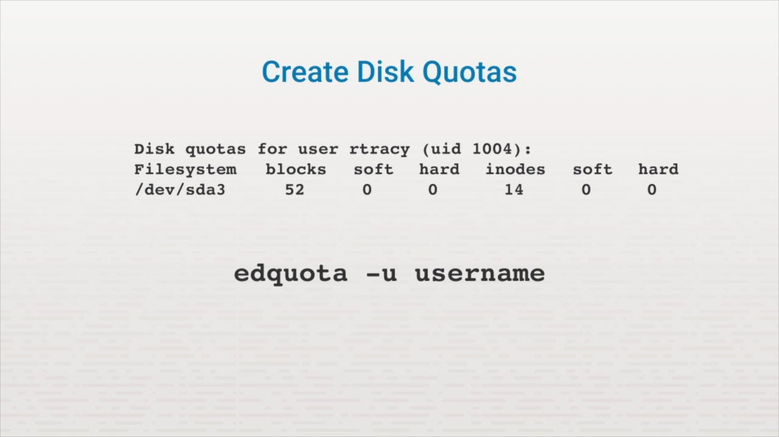
Disk Quotas

Slide 25
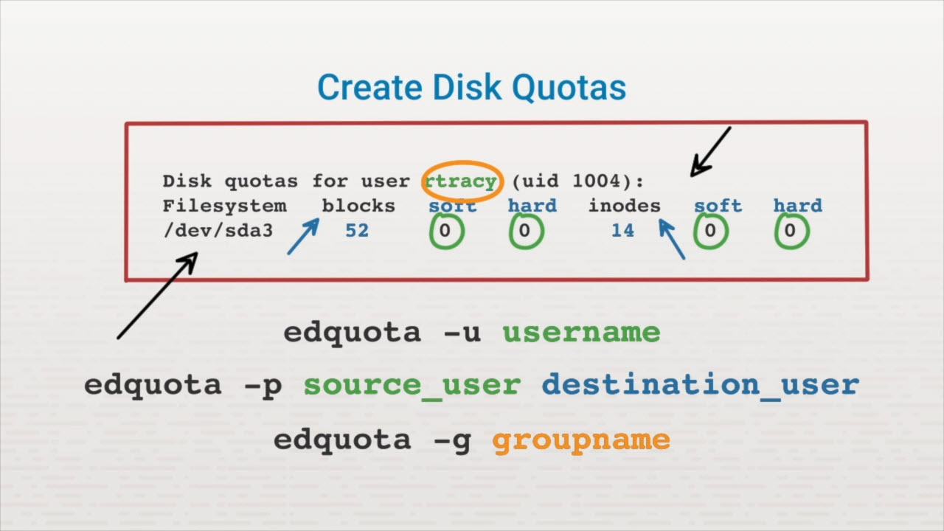
Disk Quotas

Slide 26
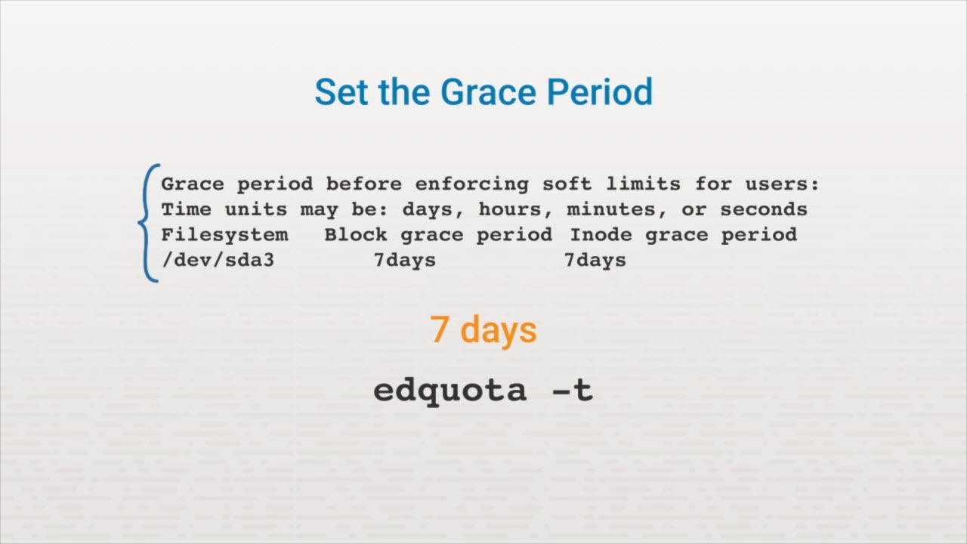
Disk Quotas

Slide 27
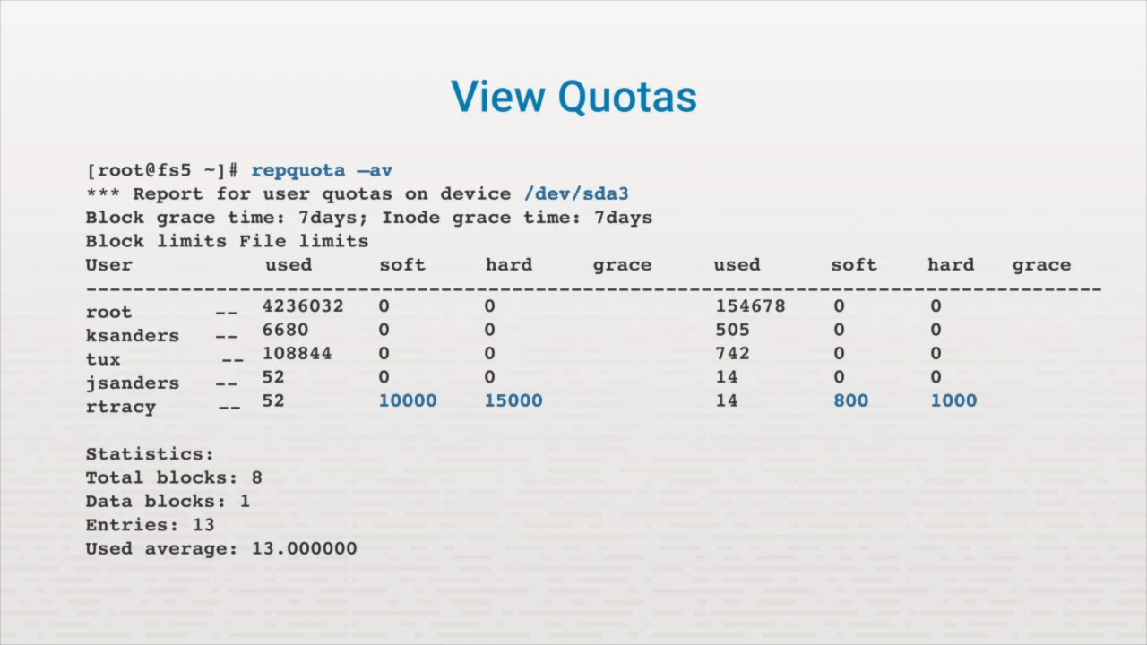
Disk Quotas

Slide 28
Ownership
How ownership works
chown & chgrp commands

Slide 29
Key Terms/Definitions
Ownership
Every file is owned by a specific user (or UID) and a specific group (or GID).

Slide 30
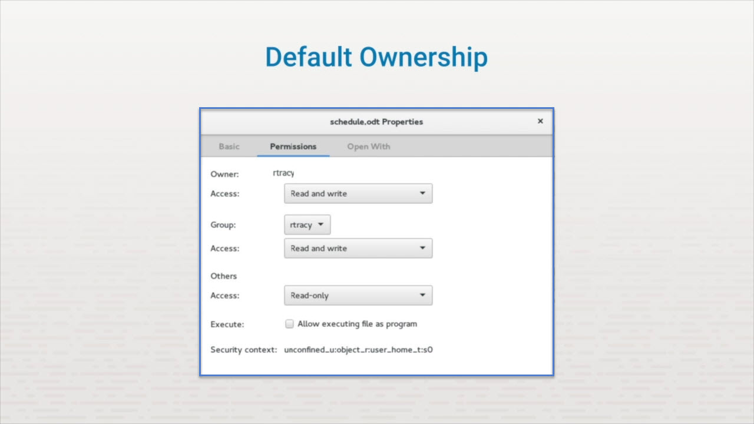
Ownership

Slide 31
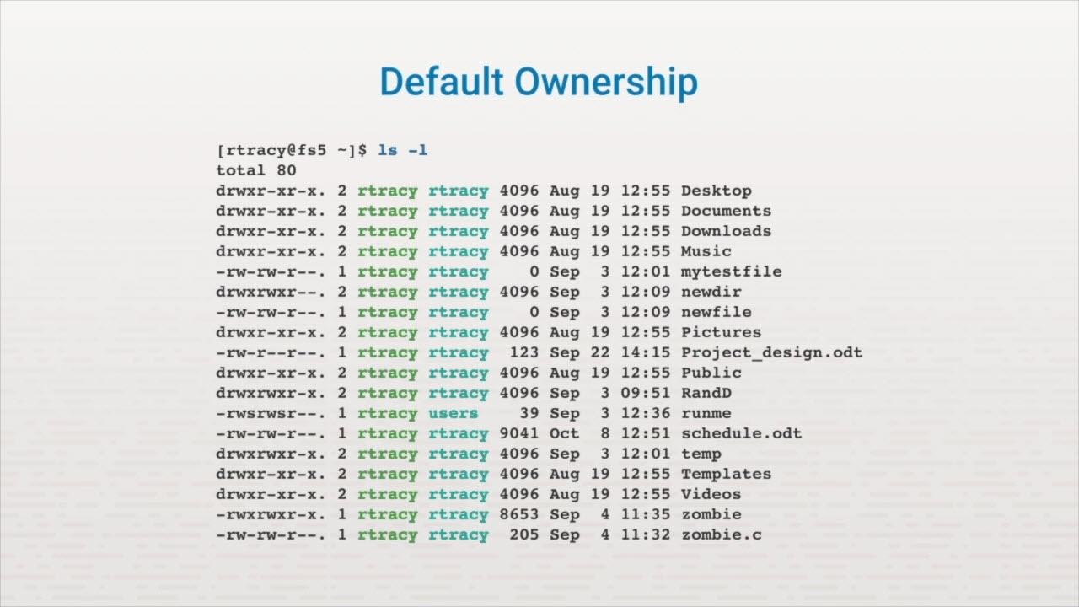
Ownership

Slide 32
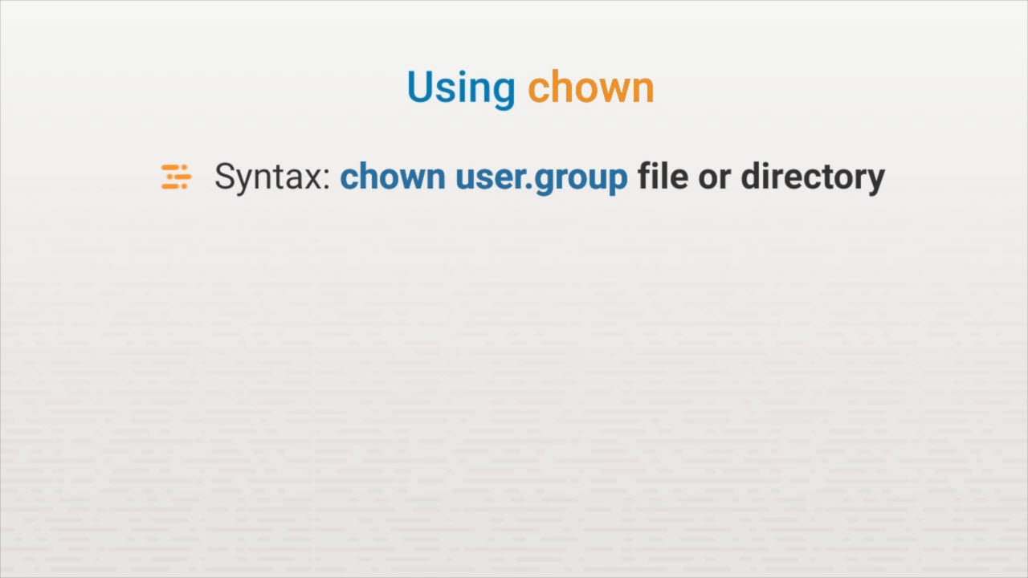
Ownership

Slide 33
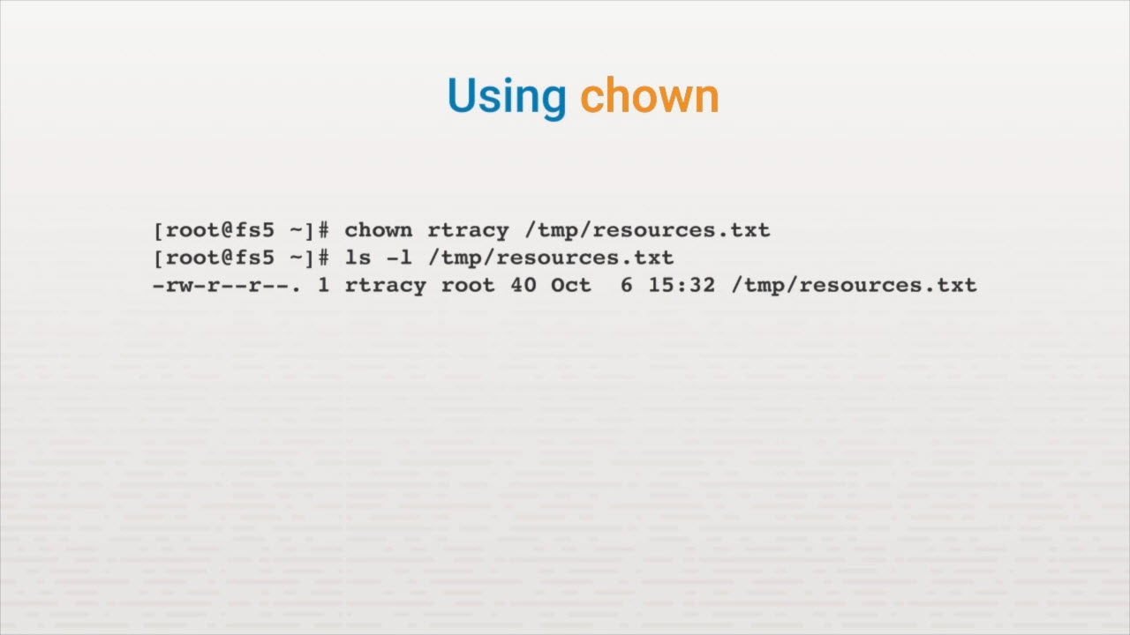
Ownership

Slide 34
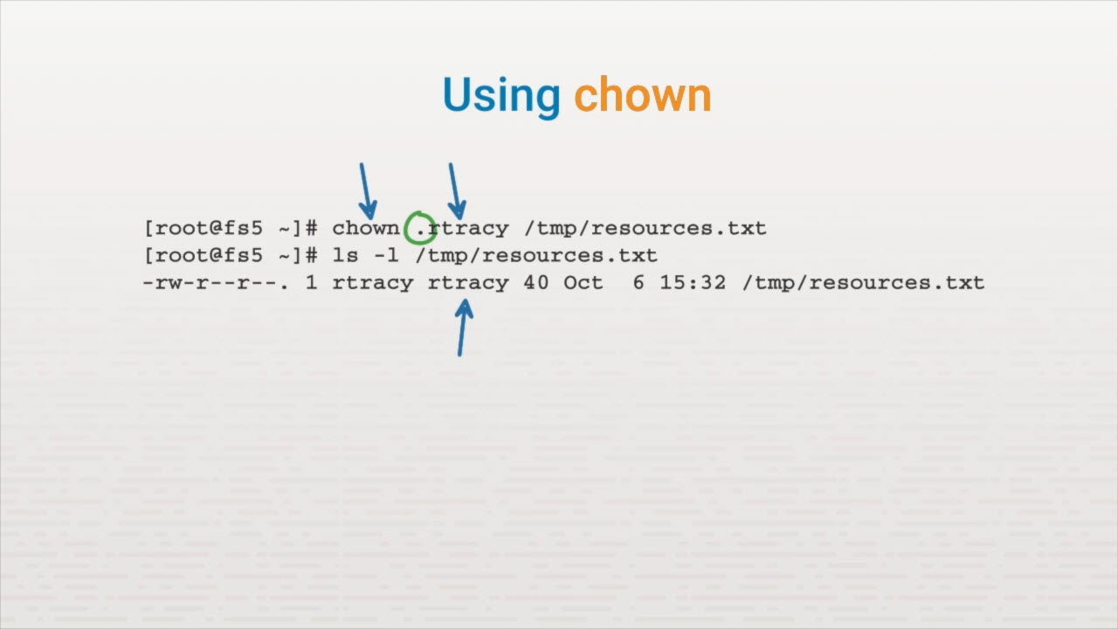
Ownership

Slide 35
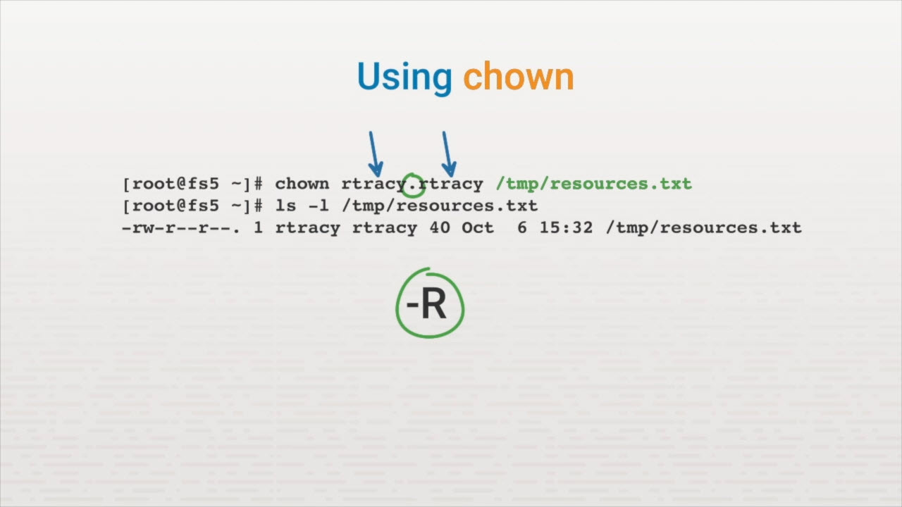
Ownership

Slide 36
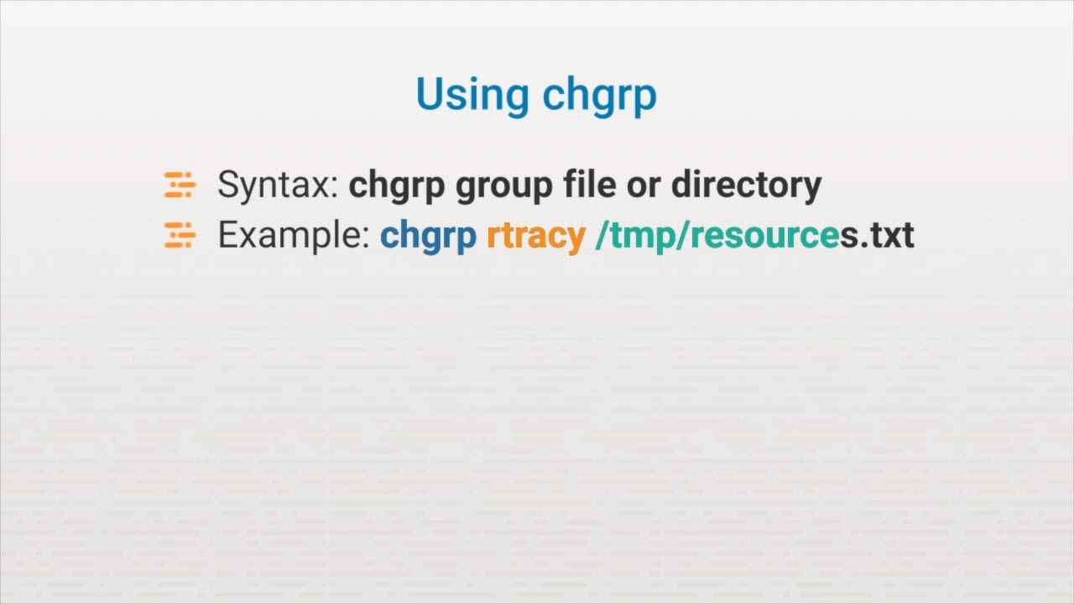
Ownership

Slide 37
Permissions

Slide 38
Key Terms/Definitions
Inode
Permissions
An inode is a data structure on a filesystem on Linux that stores all the information about a file except its name and its actual data. This includes such things as when it was last modified, size, data block location, permissions, and ownership.
The ability to grant a user read, write, and execute for a file and directory.

Slide 39
The unmask Command
umask's effect
How to modify umask

Slide 40
Key Terms/Definitions
unmask
The value used to restrict the permissions for a file or directory.

Slide 41
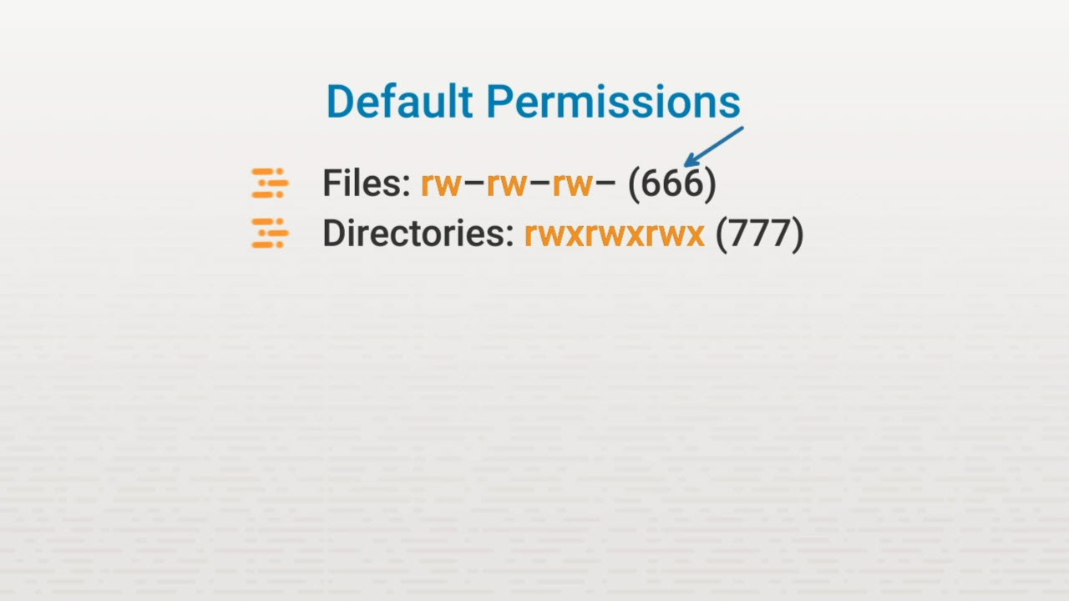
The umask Command

Slide 42
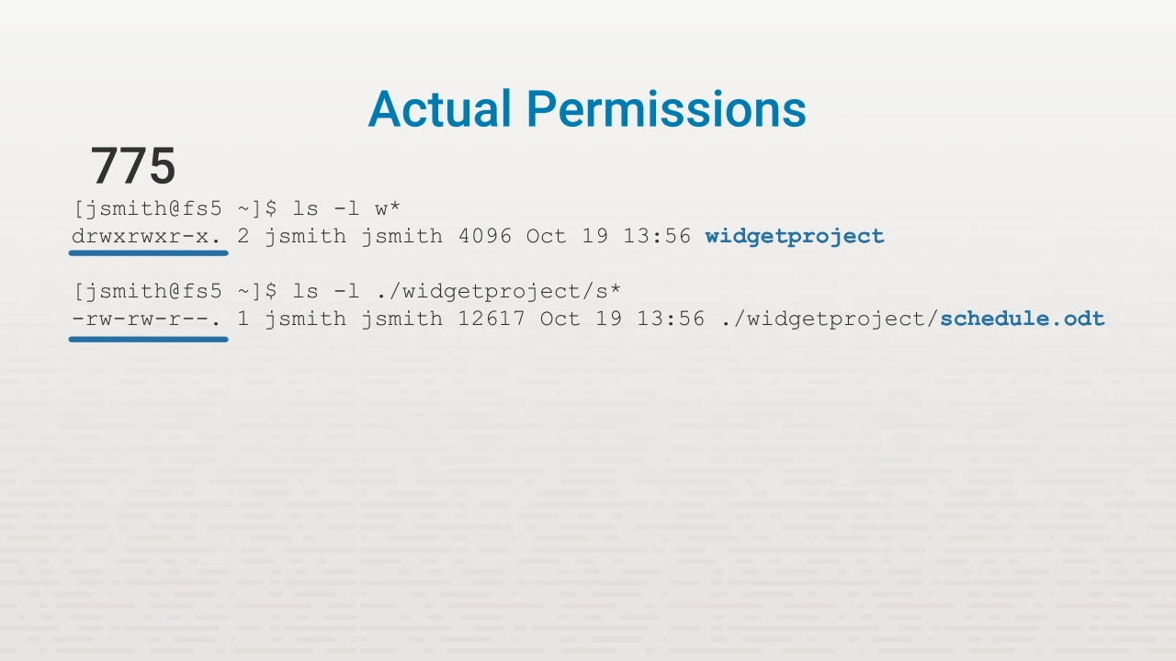
The umask Command

Slide 43
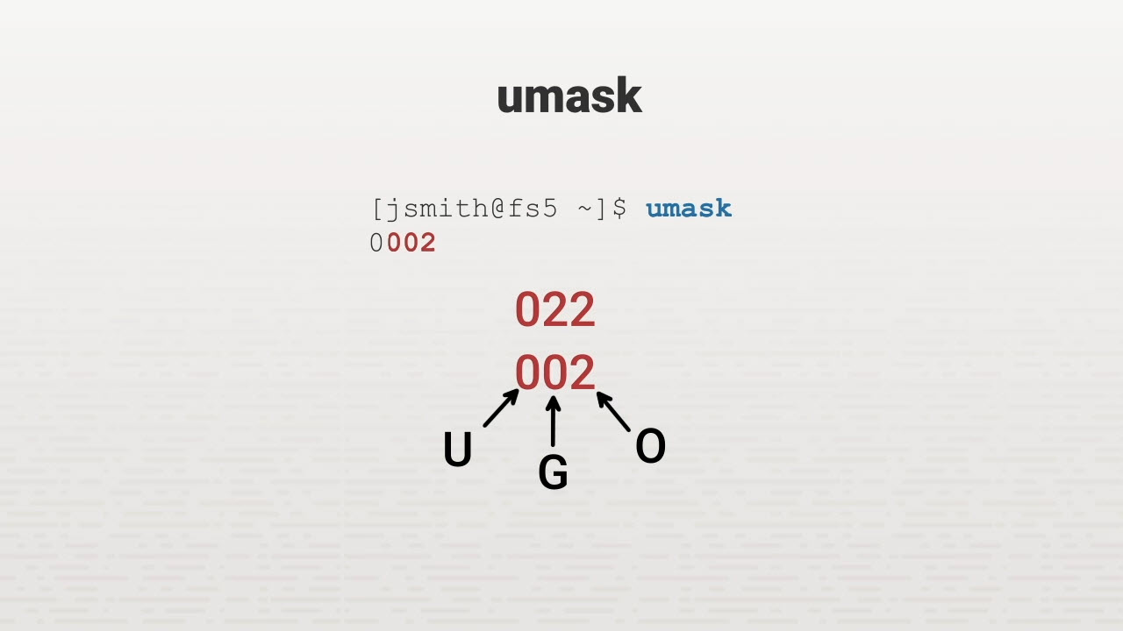
The umask Command

Slide 44
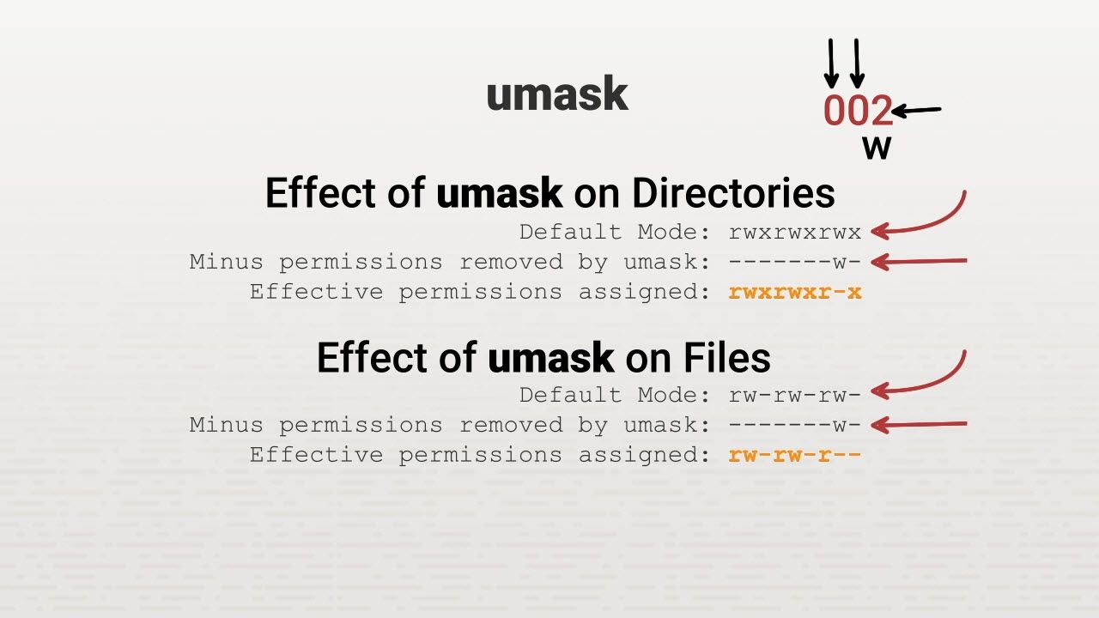
The umask Command

Slide 45
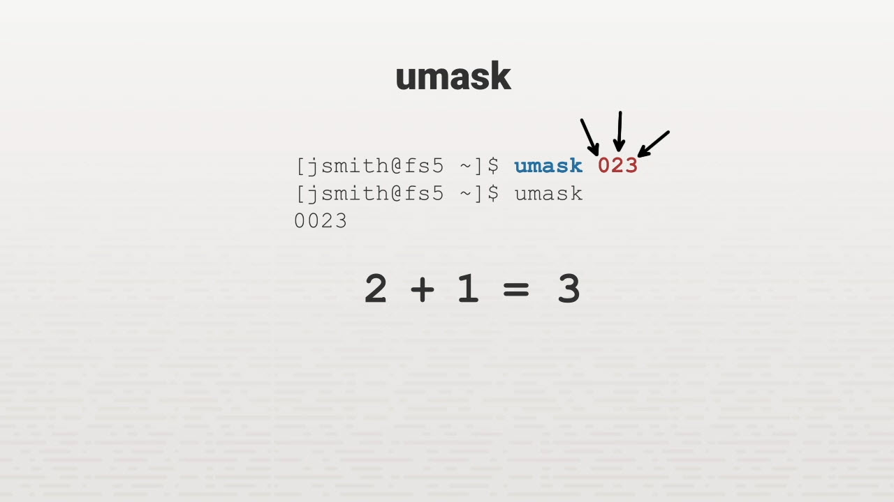
The umask Command

Slide 46
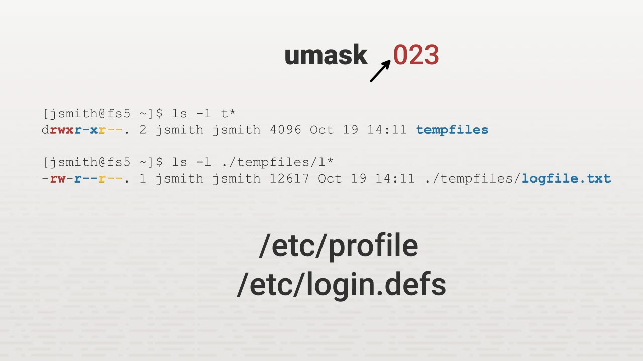
The umask Command

Slide 47
Special Permissions
Special permissions
Set user ID & group permissions
Sticky bit
The chmod command

Slide 48
Key Terms/Definitions
Set owner user ID on execution (SUID)
Set group ID up on execution (SGID)
Sticky bit
A special type of file permission given to a file. This permission grants a user temporary permission to run a program or file with the file owner's permissions.
A special file/directory permission given to a file. This permission grants a user temporary membership to a group so he or she can execute the directory, file, program, or command.
An attribute that marks a file or directory to prevent anyone except the file owner from executing deletion.

Slide 49
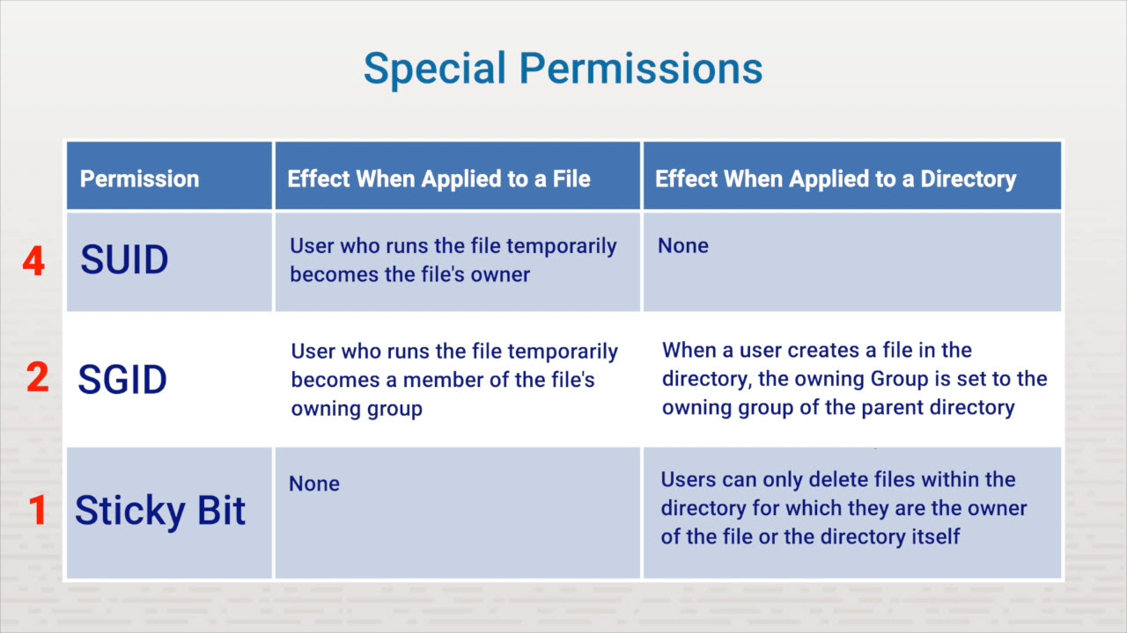
Special Permissions

Slide 50
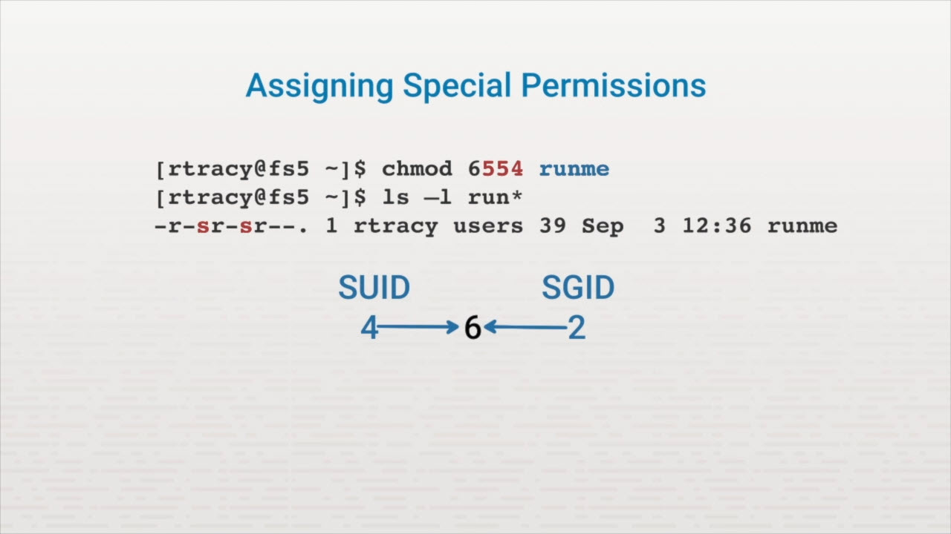
Special Permissions

Slide 51
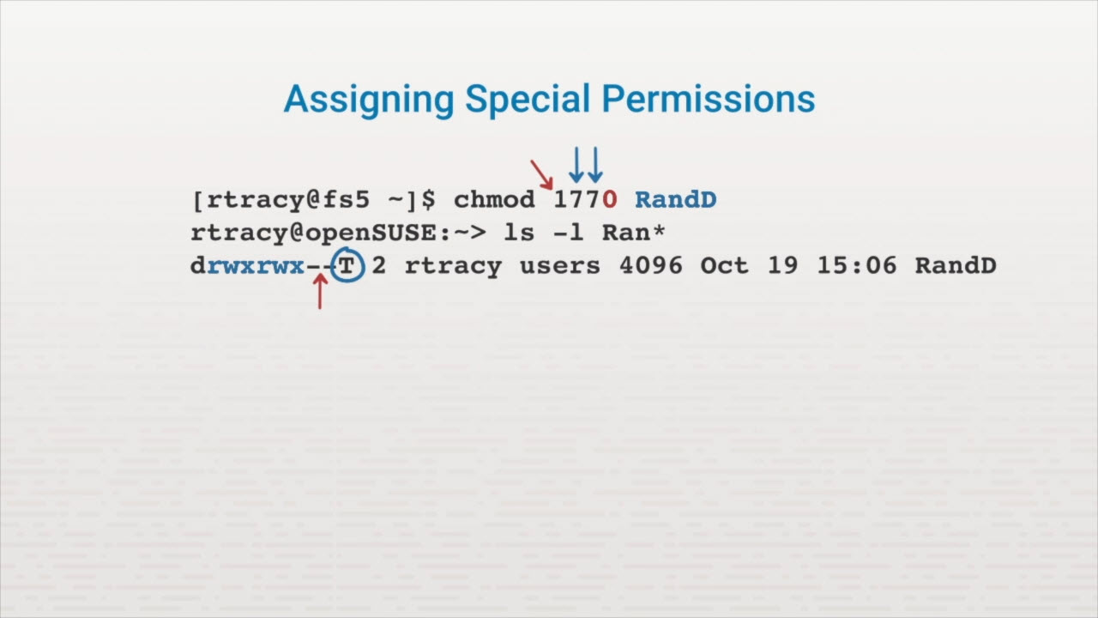
Special Permissions

Slide 52
Access Control Lists
Standard permissions
setfacl
getfacl

Slide 53
Key Terms/Definitions
ACLs
Default ACLs
Permissions assigned to users or groups beyond the standard owning user and owning group.
ACLs that are set on directories and inherited by any file or folder that's created inside of the directory.

Slide 54
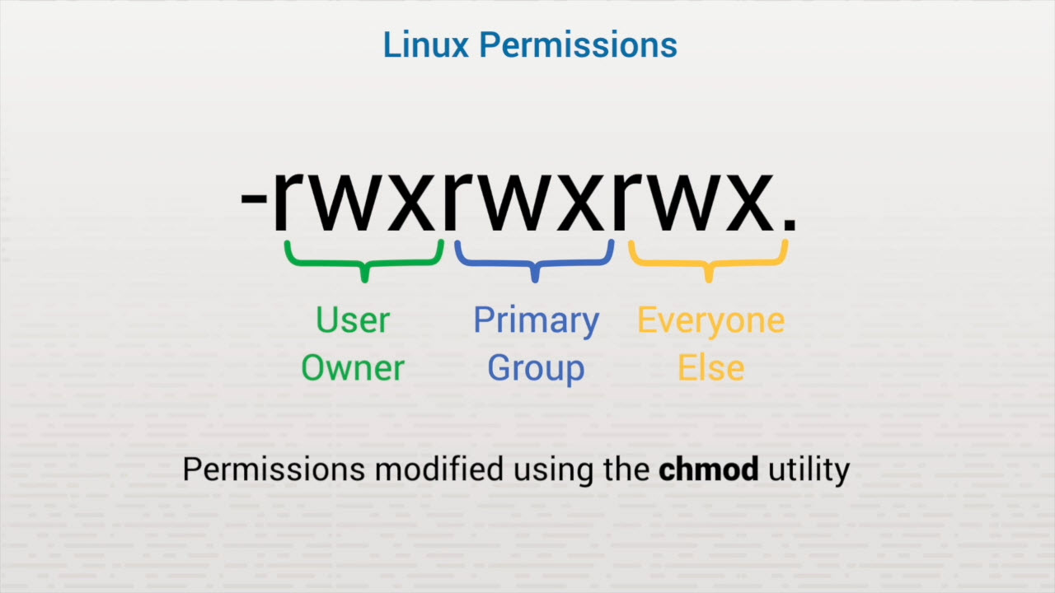
Introduction to ACLs

Slide 55
FACLs
Additional permissions to files and directories Permissions set for users or groups setfacl and getfacl utilities

Slide 56
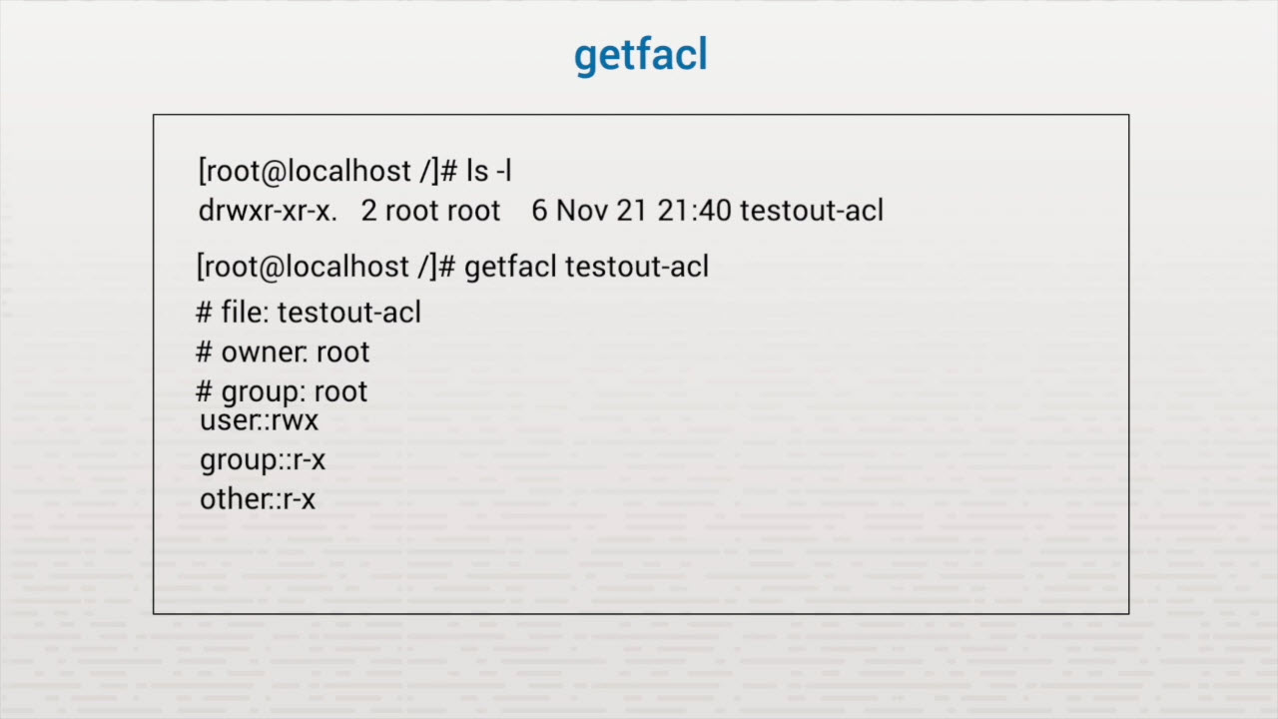
Introduction to ACLs

Slide 57
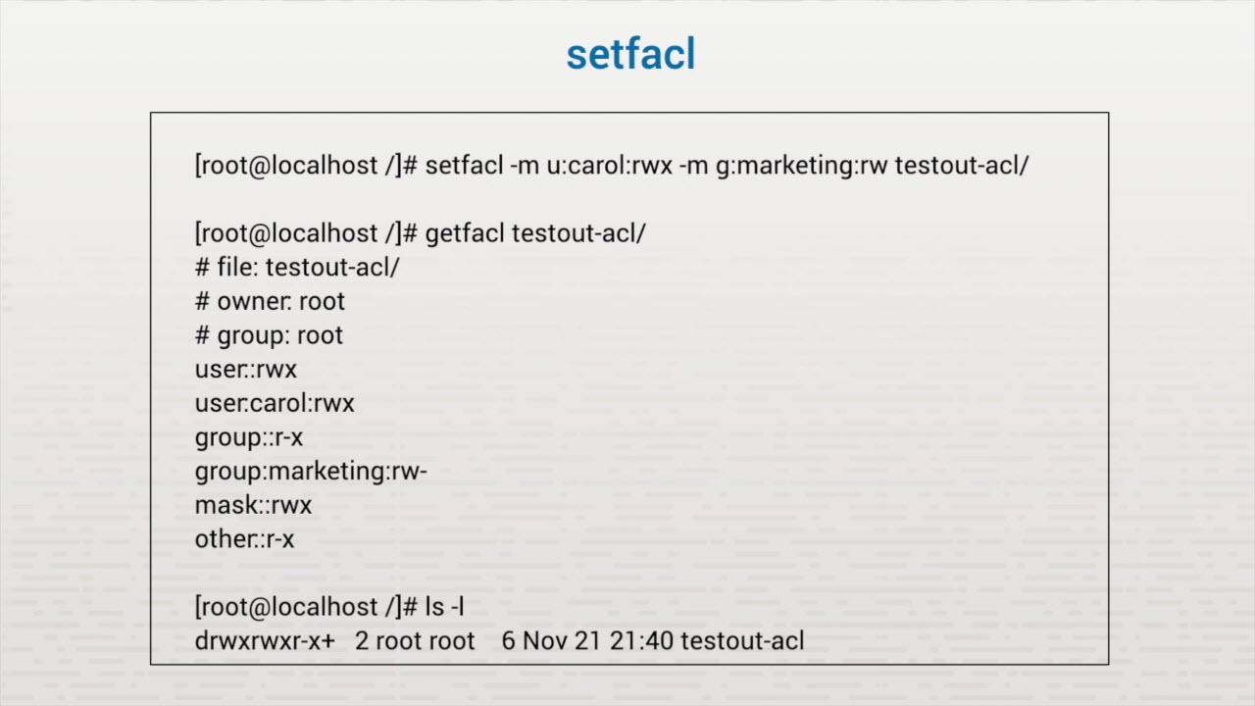
Introduction to ACLs

Slide 58
Archive and Backup
File archives (Create an archive, Extract from an archive, Compress an archive)
The cpio command (Create archive files, Compress an archive, Extract files from an archive, Extract files from a compressed archive)
The dd command (copy files, partitions, and disk with dd; back up MBR)

Slide 59
Key Terms/Definitions
Full backup
Incremental backup
Differential backup
Snapshot clones backup
A copy of all the files that exists at the point in time when the backup is taking place.
An incremental backup stores files that have been changed or added since the last backup has been made.
A differential backup copies all of the files that have been updated since the last full backup.
A snapshot is copy of blocks of data that make up a set of files at a point in time. This feature allows you to take point-in-time snapshots of the files on a system without causing the downtime inherent in traditional backups.

Slide 60
Key Terms/Definitions
Image backup
Message Digest Algorithm 5 (MD5)
Secure Hash Algorithm (SHA)
A single computer file or set of files that contain the contents of a hard disk created by copying the disk sector-by-sector. It's also called a system image.
An algorithm that produces a 128-bit hash value.
A cryptographic hash function that takes an input and produces a 160-bit (20-byte) hash value known as a message digest. SHA is typically rendered as a 40-digit hexadecimal number.

Slide 61
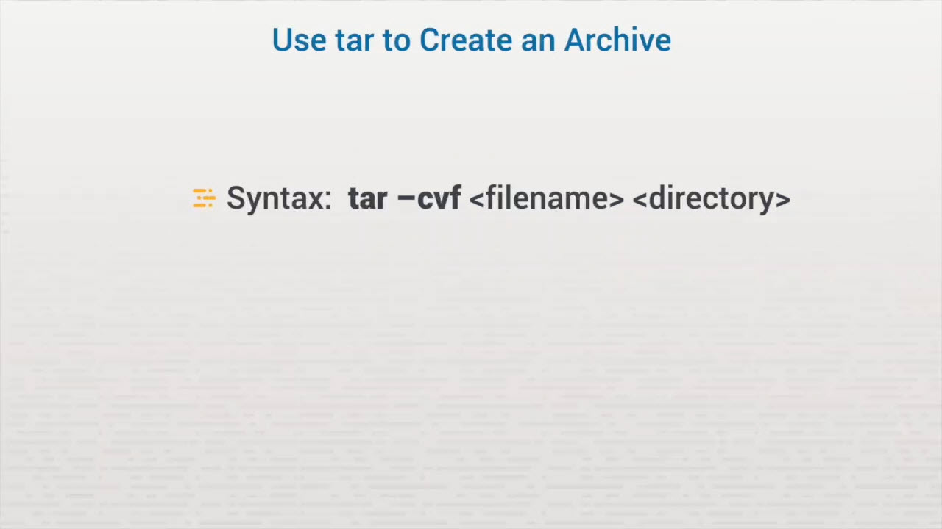
File Archives

Slide 62
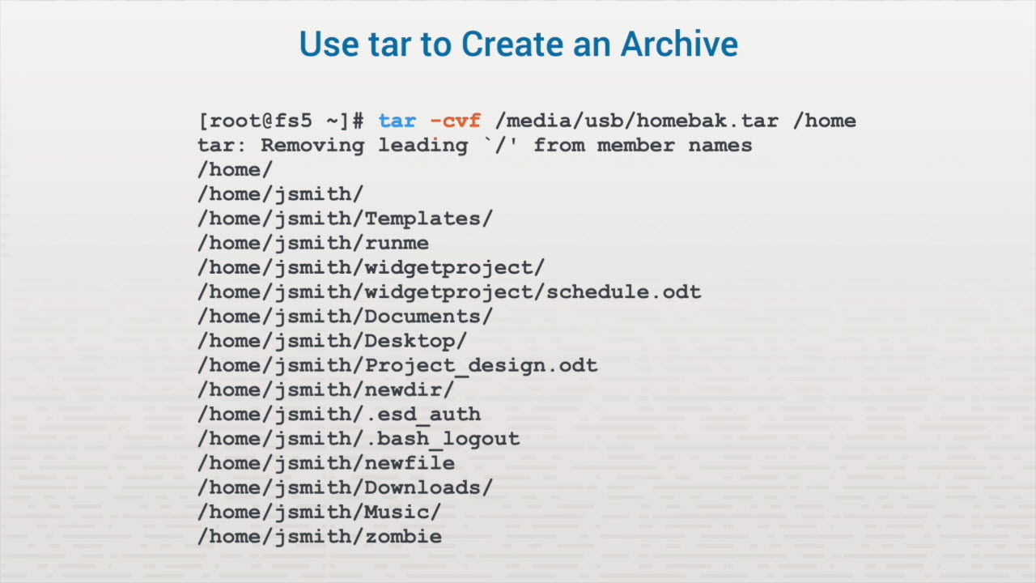
File Archives

Slide 63
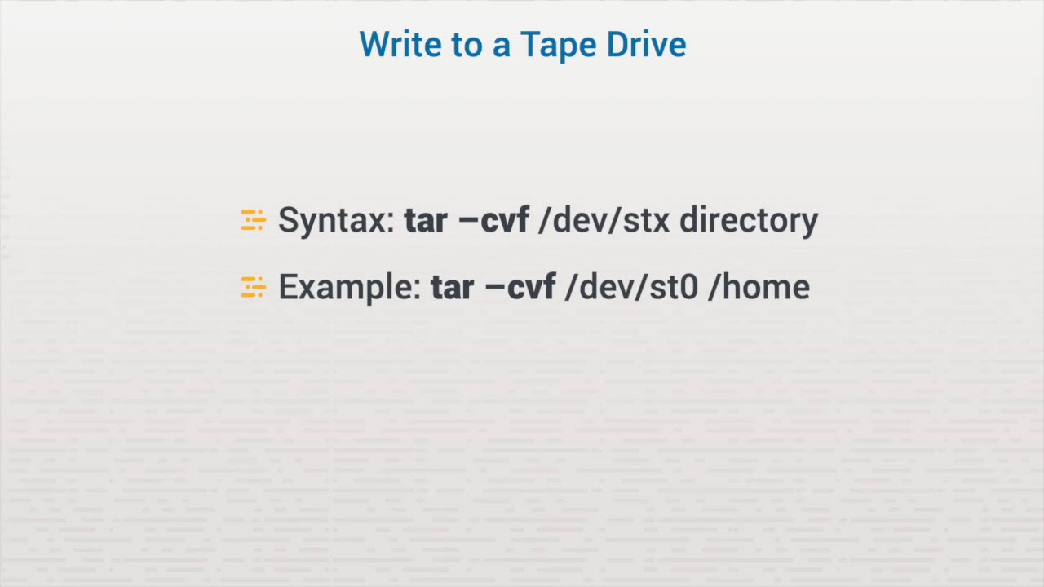
File Archives

Slide 64
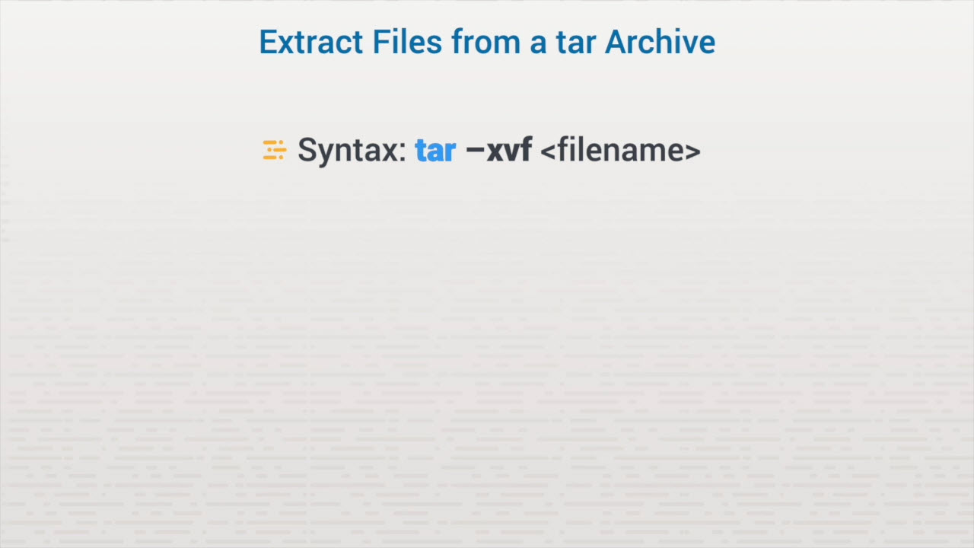
File Archives

Slide 65
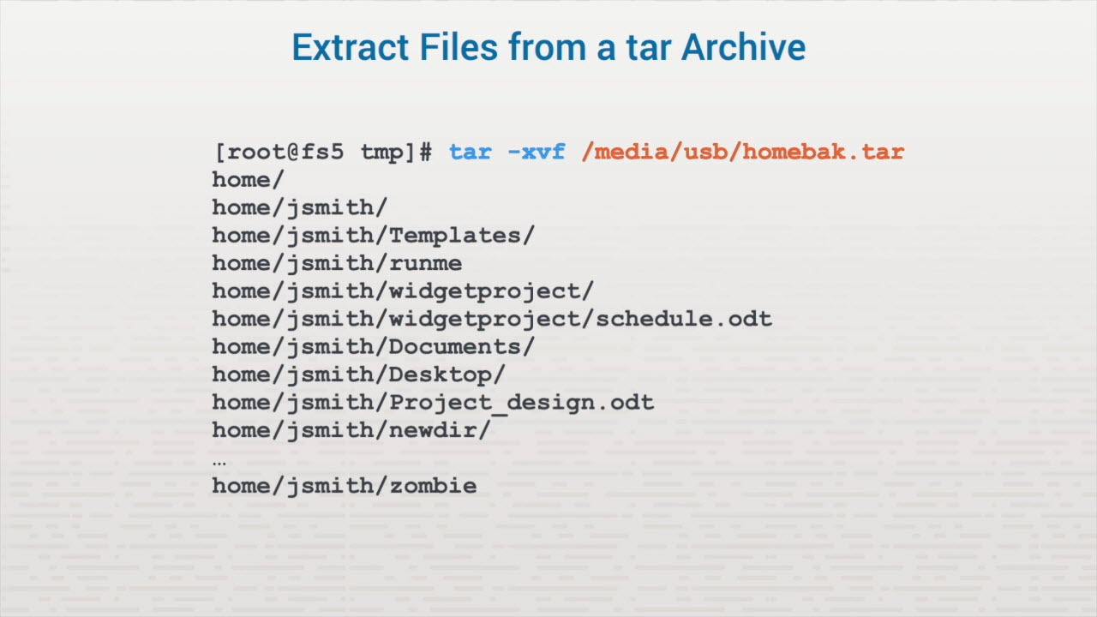
File Archives

Slide 66
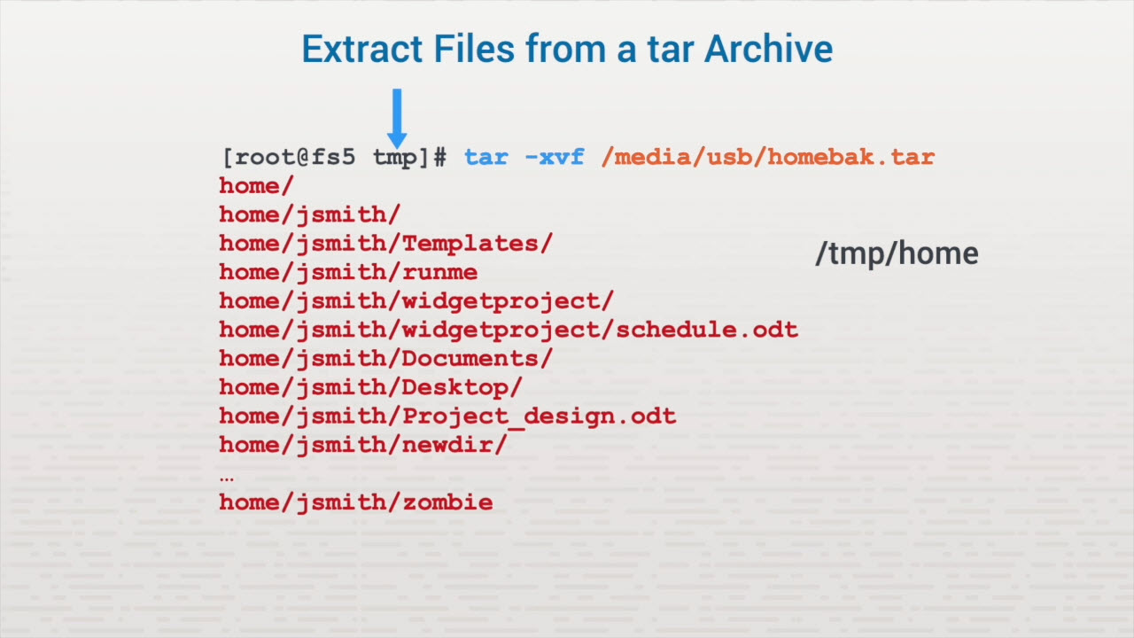
File Archives

Slide 67
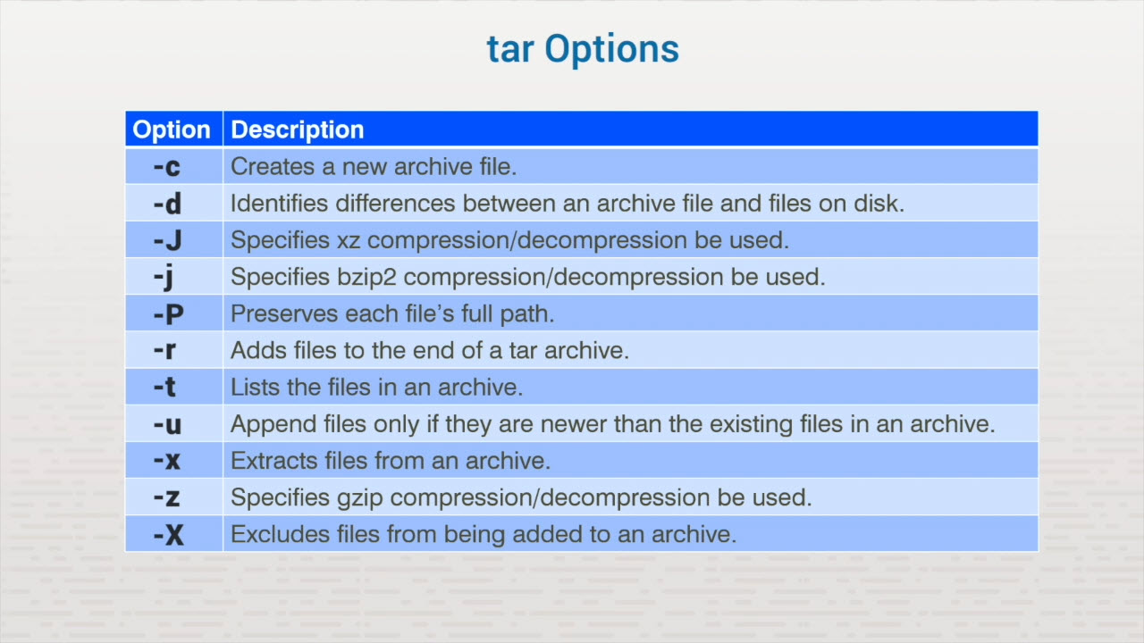
File Archives

Slide 68
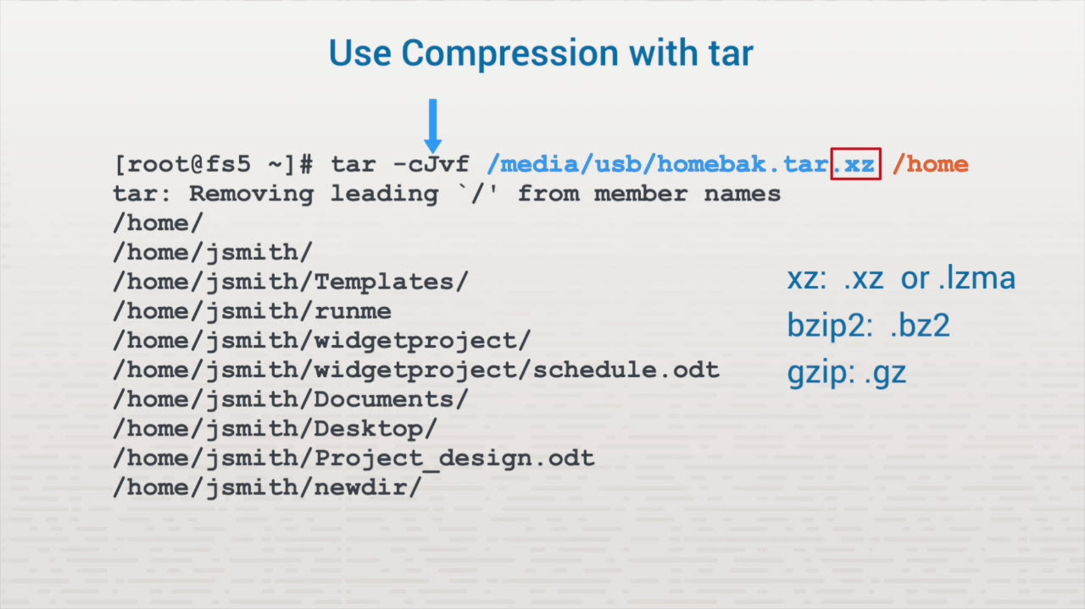
File Archives

Slide 69
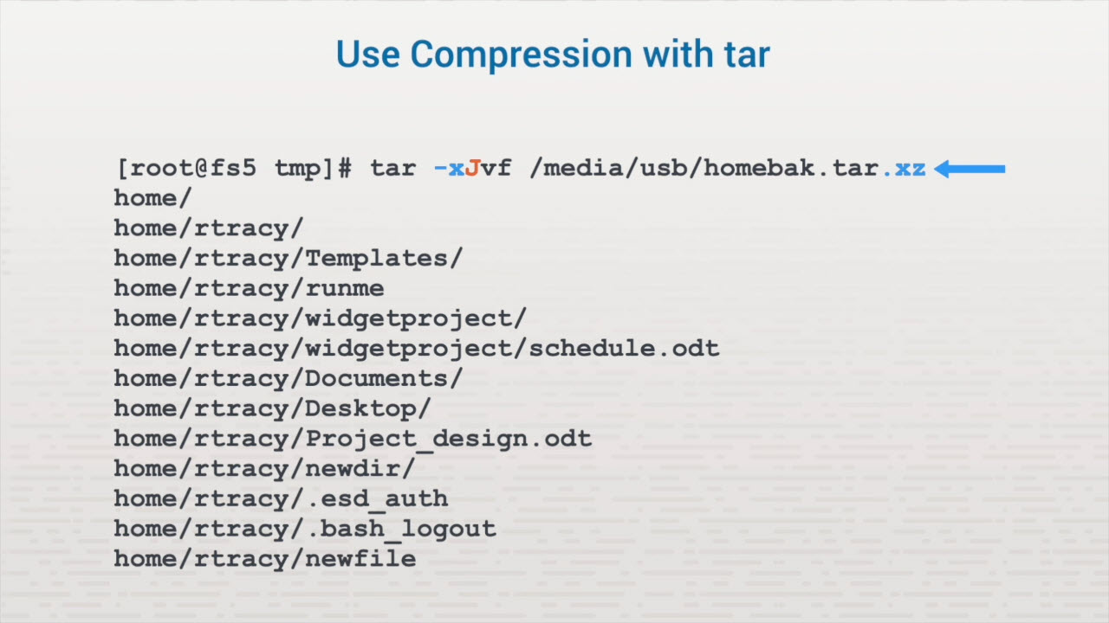
File Archives

Slide 70
Create a cpio Archive
cat <file_name> | cpio cat: finding scattered files find: finding a specific file ls: adding files from a single directory

Slide 71
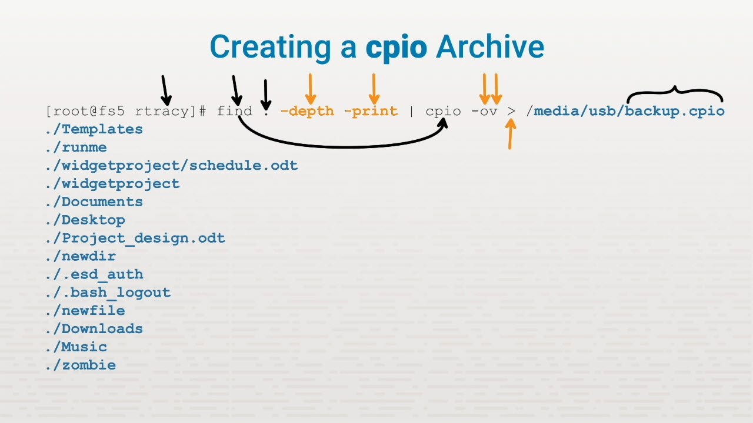
The cpio command

Slide 72

The cpio command

Slide 73

The cpio command

Slide 74

The cpio command

Slide 75

The cpio command

Slide 76

The dd command

Slide 77

The dd command

Slide 78

The dd command

Slide 79

The dd command

Slide 80

The dd command

Slide 81
Troubleshooting Storage
Common storage issues
High latency
Low throughput
Capacity
File system
Hardware
Mounting

Slide 82
Key Terms/Definitions
IOPS
inode
Input/output operations per second. This is a performance metric that's useful in troubleshooting storage issues.
The index node that references file storage locations. One inode is needed for each file on certain Linux file systems.

Slide 83
Common Issues
High latency Low throughput Capacity File system Hardware Mounting

Slide 84

Common Storage Issues

Slide 85

Common Storage Issues

Slide 86
Low Throughput
Low latency = higher throughput High latency = lower throughput

Slide 87

Common Storage Issues

Slide 88
Capacity Issues
Required space Type of data Storage format Increased latency File system corruption inode exhaustion

Slide 89
File System Issues
File corruption File system recovery
fsck Like chkdsk Third-party utilities
Mismatch
kilobyte vs. kibibyte
kilo = 1,000 bytes kibi = 1,024 bytes
Resizing a partition Sparse files
dd can commit the reserved space

Slide 90

Common Storage Issues

Slide 91
I/O Schedulers
Improve throughput Balances with fair access Non-multiqueue
deadline Completely Fair Queuing (ch) noop (no-operation)
Multiqueue
Budget Fair Queuing (bfq) kyber None

Slide 92

Common Storage Issues

Slide 93
Mount Option Issues
Make sure the file system is loaded on the local Linux system You must have the credentials and IP info of the foreign system The local mount point must exist Specific options
Read-only (RO) remount

